Slide 1

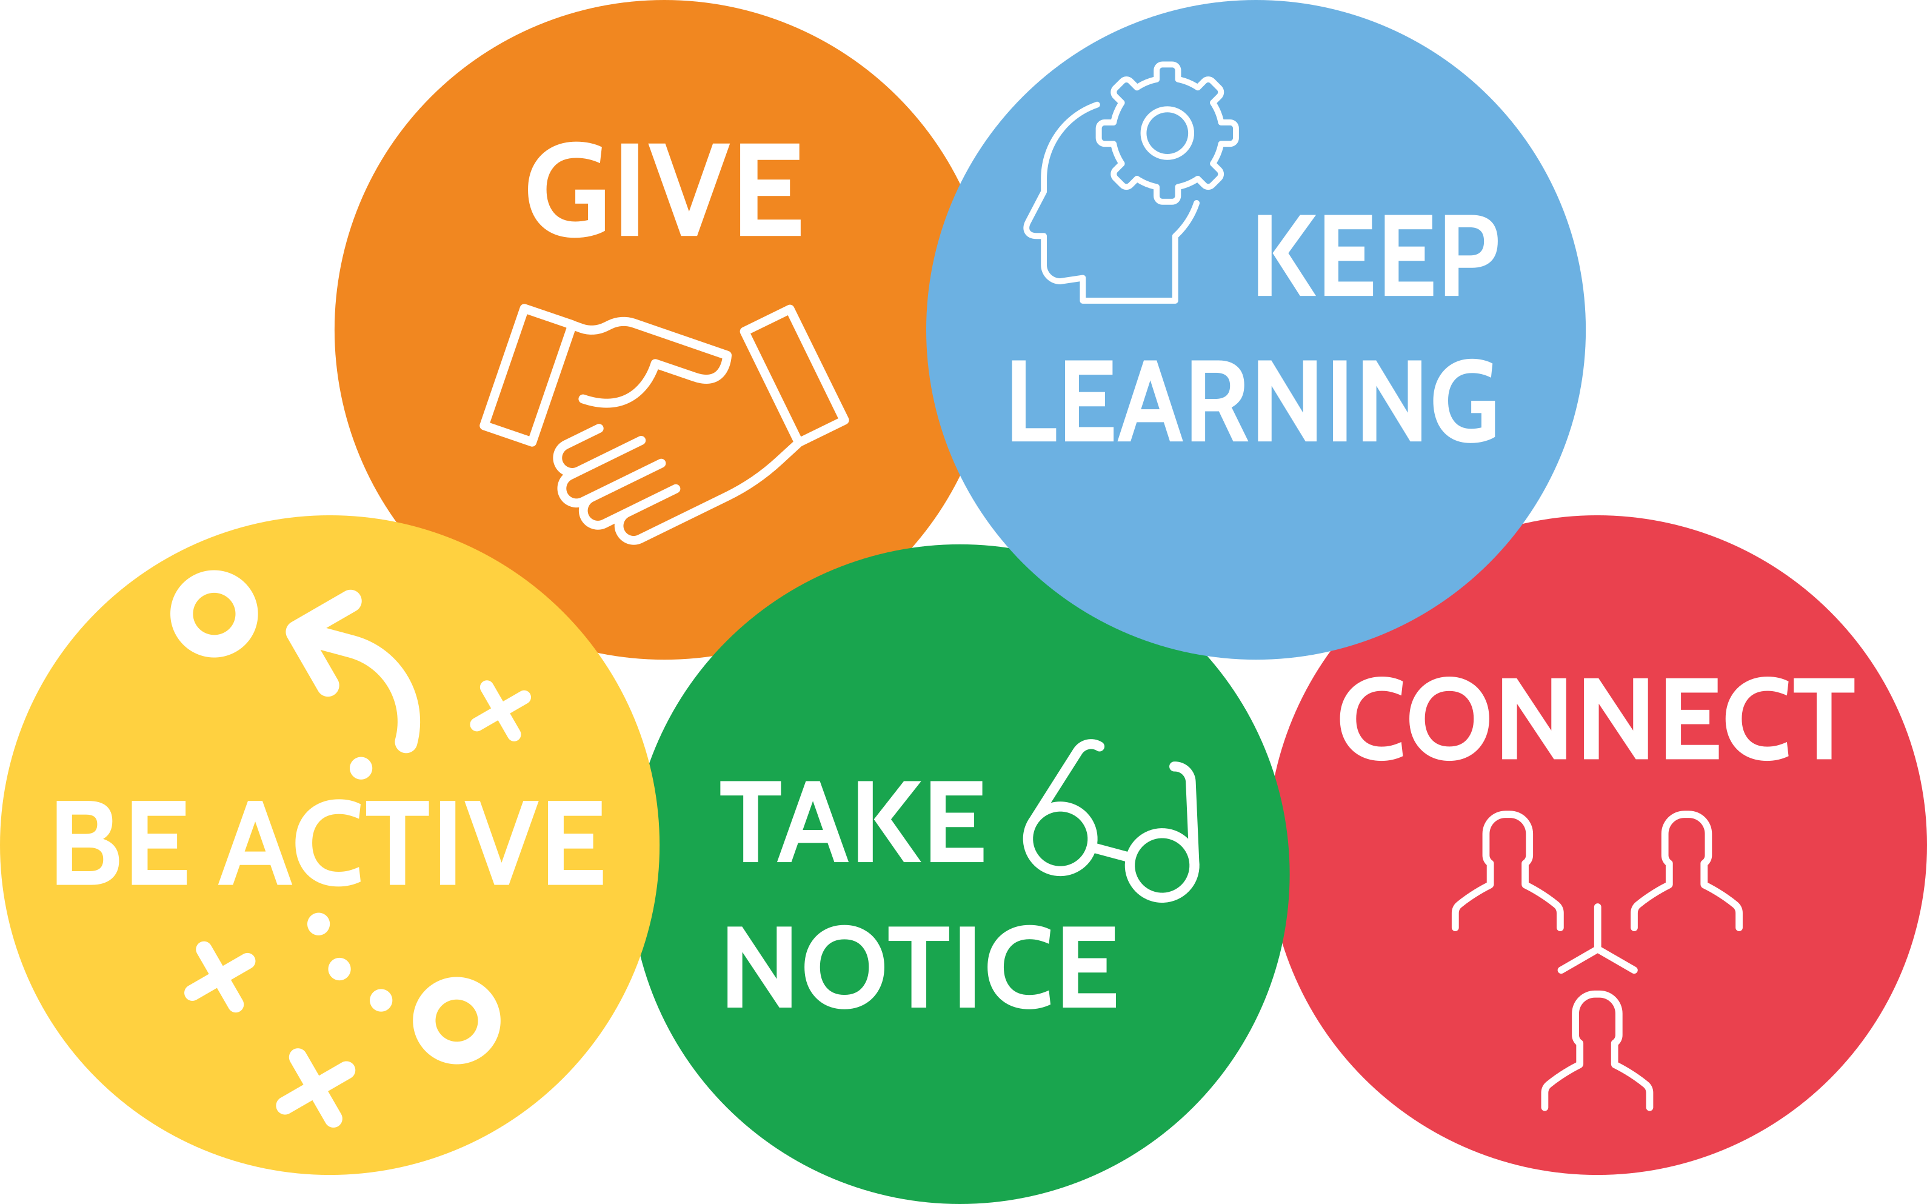
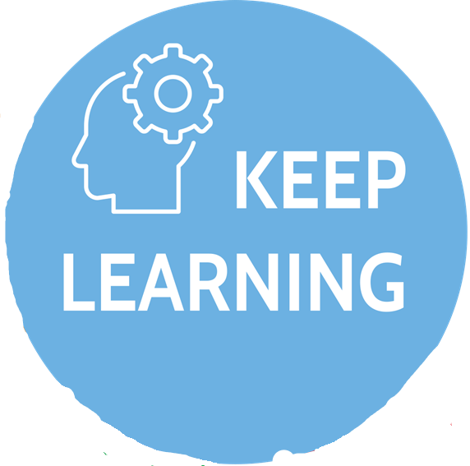

Slide 2

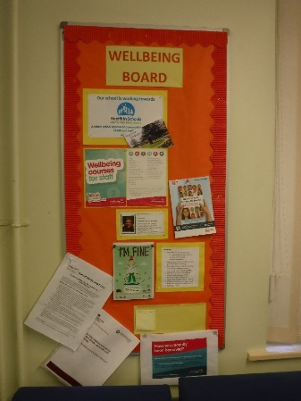
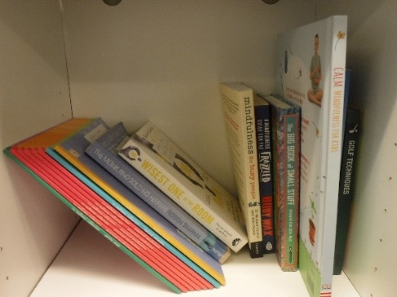
We started learning about it!
Mental Health and Wellbeing has become a ‘usual’ word to use in school. To be honest when we started this award scheme I could not imagine that we would refer to it as much as we do and this is largely down to the Deputy Head’s leadership (Paul Rowsell) and his commitment to get behind the project for both Children and Staff.
Planning the year - with Emma’s assistance and creating achievable goals
Staff Well Being Questionnaire - Survey Monkey which has since been refined
Reading Well Book Launch - led to having a book shelf in the staff room.
Noticeboards in the staff room and for parents have up to date information - bereavement information
Youth First Aid Course - covered adult theme

Slide 3


Slide 4
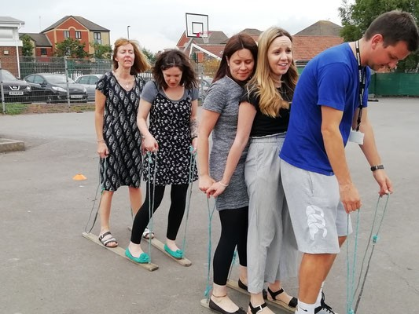
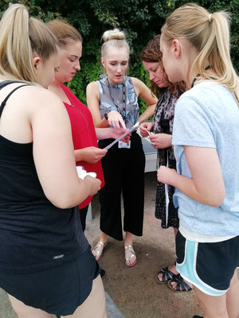
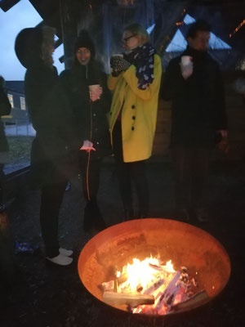
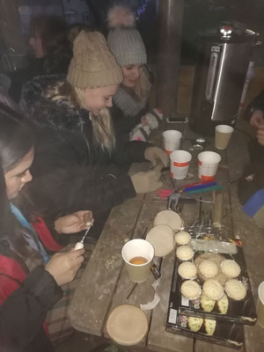
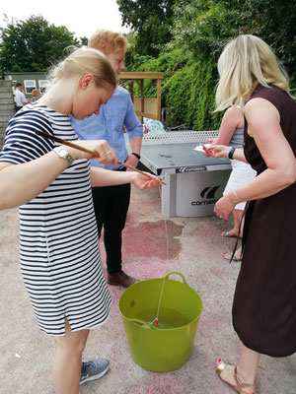
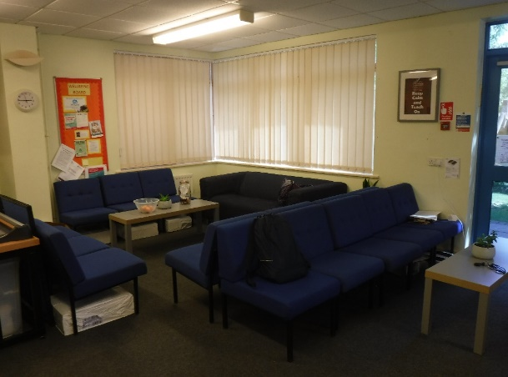
Staff Meetings for Fun
Escape the Playground
Christmas decoration making and fire
Bingo and Quiz Night
Afternoon Tea for leaving staff
Made staffroom appealing

Slide 5


Slide 6
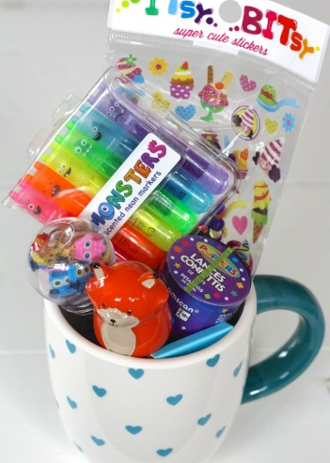
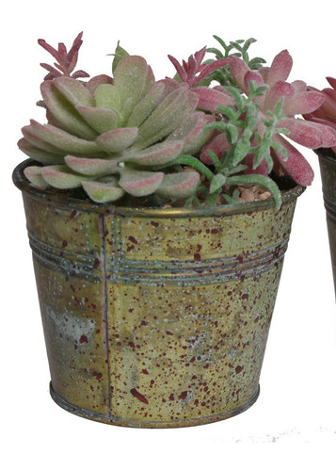
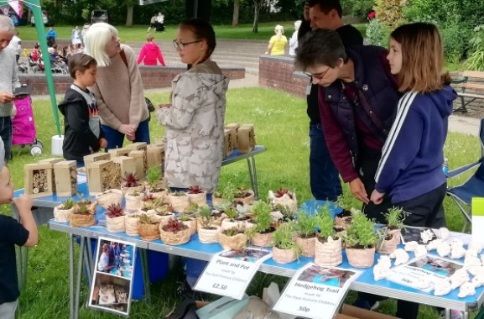
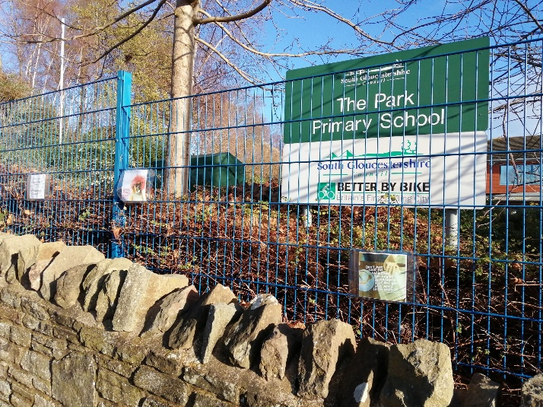
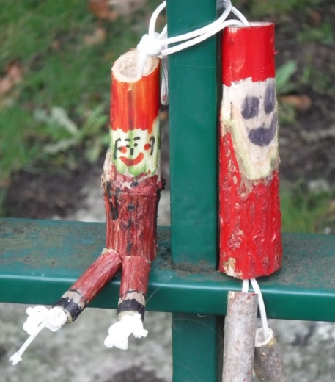

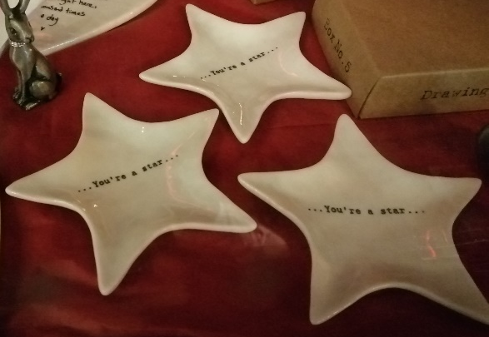
Cup of Kindness
Christmas ½ day
Community Wellbeing posters
Regular charity events
Plants in a Pot
Santa in the Park

Slide 7


Slide 8
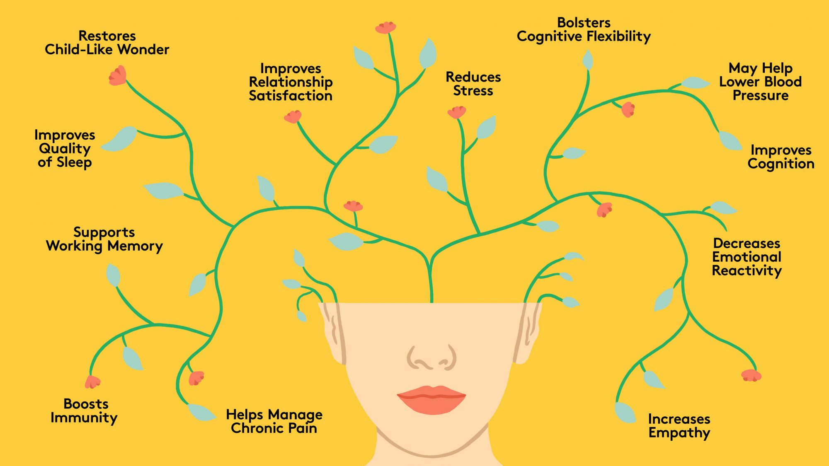
Mindfulness
Rules for emailing/whats apps out of hours.
Staff Yoga (postponed)
Jigsaw with the children
Notes with plants and wellbeing mug

Slide 9


Slide 10
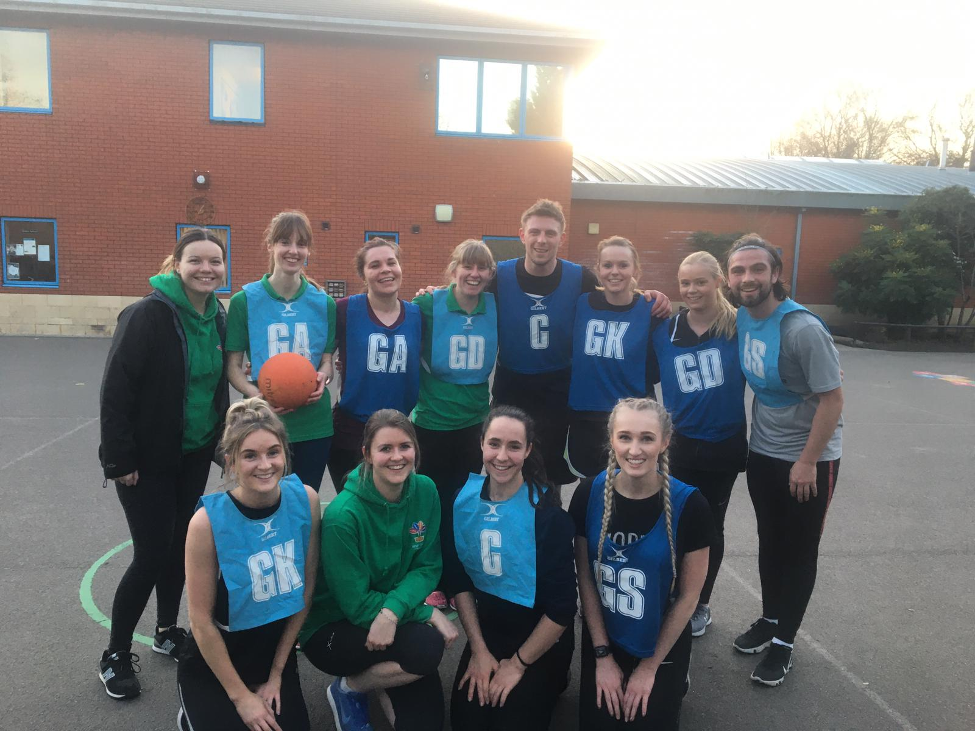
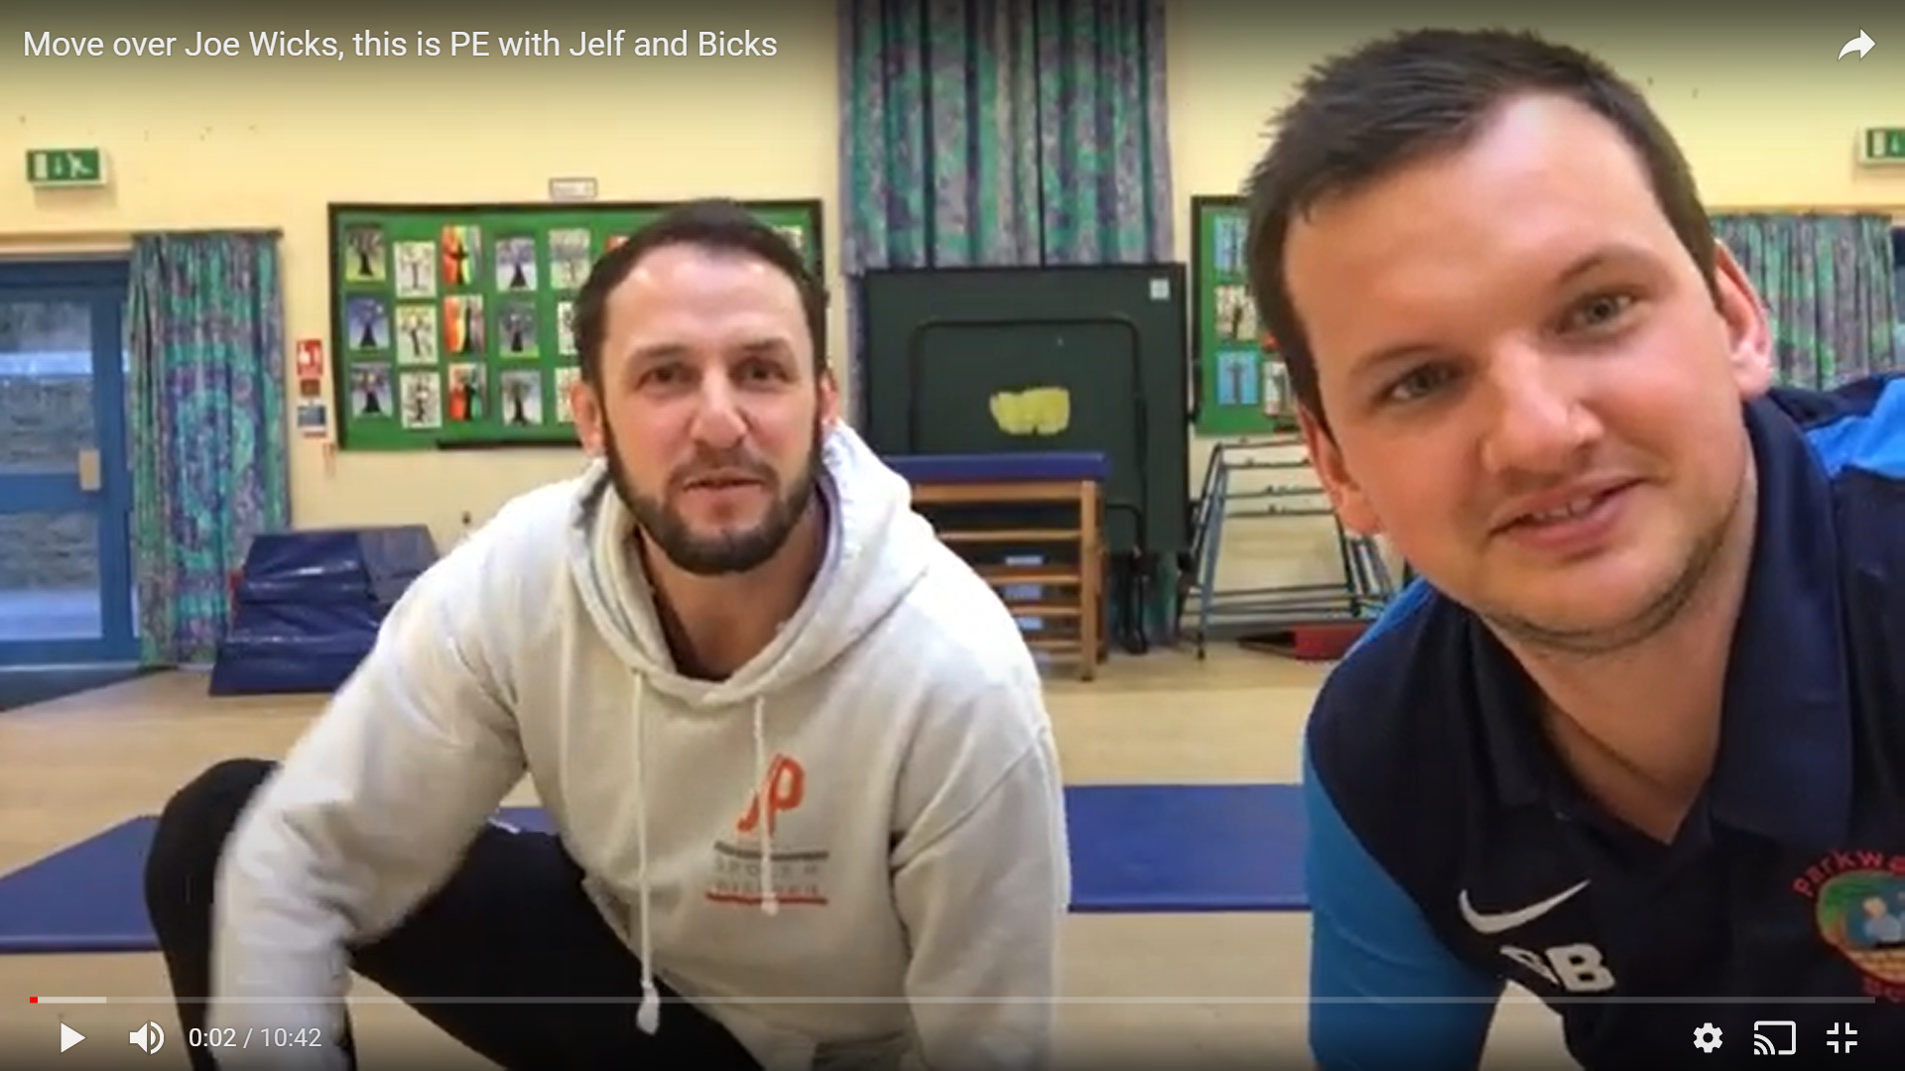
Staff sports teams
Regular whats app recommendations

Slide 11
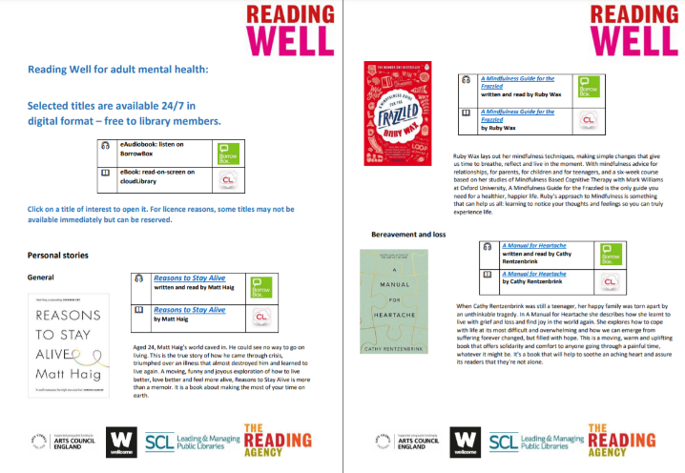
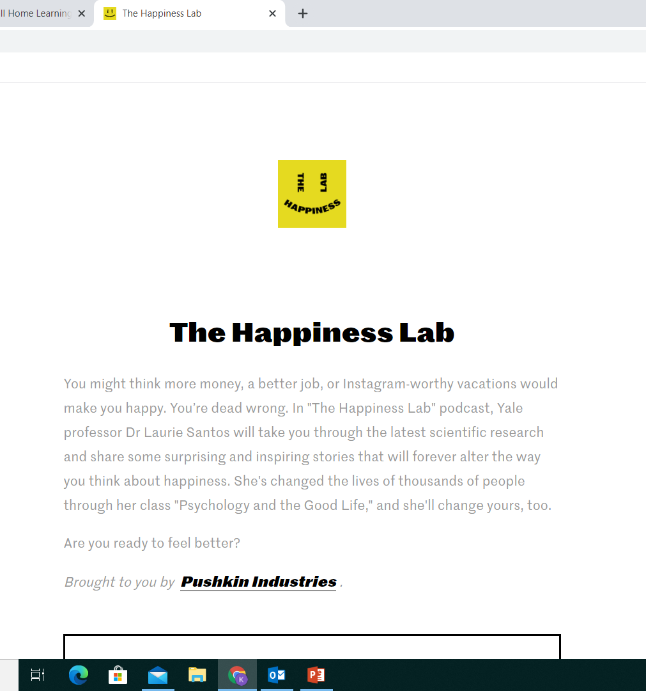
Children’s Mental Health Week – 1 – 7th February 2021. https://www.childrensmentalhealthweek.org.uk/
World Mental Health Day – 10th October 2021. https://www.mentalhealth.org.uk/campaigns/world-mental-health-day
Mental Health Awareness Week – 10th – 16th May 2021. https://www.mentalhealth.org.uk/campaigns/mental-health-awareness-week
TQUK Level 2 Certificate in Understanding Children and Young People's Mental Health – free with SGS Online Learning. https://www.sgscol.ac.uk/study/online/l2-certificate-understanding-children-and-young-peoples-mental-health
Podcast for Mental Health and Well Being https://www.happinesslab.fm/
South Glos site for Mental Health and Well Being https://sites.southglos.gov.uk/mind-you/
Rebecca Loaring. Specialist Health Improvement Practitioner CYP Mental Health and Emotional Wellbeing – sends monthly updates with everything that you need to know.
Reading Well book lists - https://www.southglos.gov.uk/leisure-and-culture/libraries/recommended-booklist/reading-well/
JOIN IN

Slide 12


